Slide 1

Bonifacio Global City (BGC) Bus Passenger Information System: Bus Tap
Group 5
ALCARAZ, ANNA LYNN C.
ANGOT, SAMMY BOY M.
BESMANO, JUSTIN V.
BRIOSO, JOB G.

Slide 2
Introduction

Slide 3
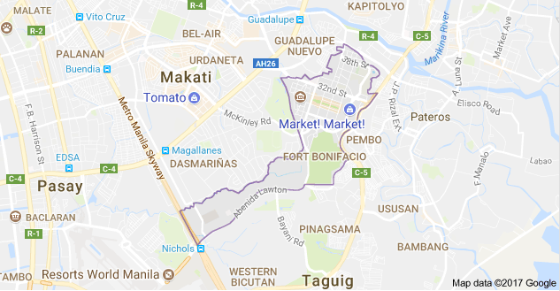
Bonifacio Global City (BGC)

Slide 4
BGC Bus
North Express
North Route
East Express
Central Route
Upper West Express
Lower West Express
Night Route
West Route
East Route
Ayala Express
Arca South Express
Nuvali Express

Slide 5
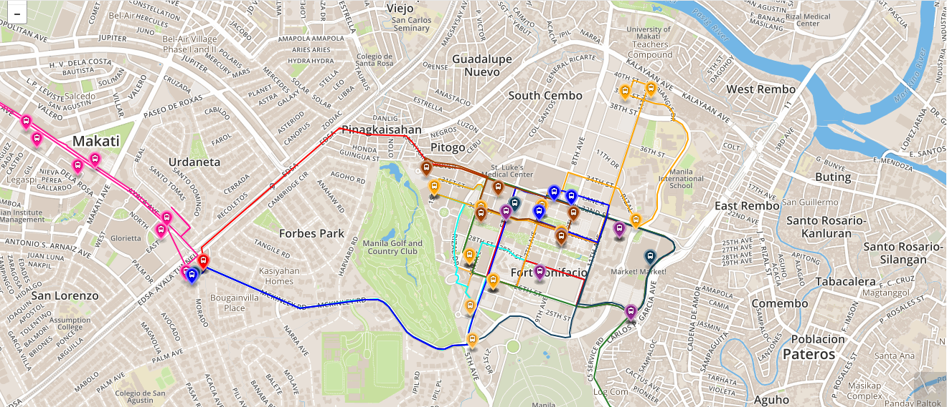
Bus Routes

Slide 6
Operating Schedule
Routes | Day | Time
North Express | Mondays to Fridays only | 6:00AM to 10:00PM
North | Mondays to Fridays only | 6:30AM to 10:00AM and 4:30PM to 8:30 PM
East Express | Mondays to Fridays only | 6:00AM to 10:00PM
Central | Everyday | 6:00AM to 10:00AM
Upper West Express | Mondays to Fridays only | 6:00AM to 10:00PM
Lower West Express | Mondays to Fridays only | 6:00AM to 10:00PM
Night | Everyday | 10:00PM to 6:00 AM
East | Weekends | 6:00AM to 10:00PM
West | Weekends | 6:00AM to 10:00PM
Ayala Express | Mondays to Fridays only | 7:00AM to 10:00AM
Arca South Express | Mondays to Fridays only | 6:10AM to 9:00AM and 4:00PM to 8:00 PM
Nuvali Express | Mondays to Fridays only | 6:30AM, 6:30PM, and 7:15PM

Slide 7


Bus Fare
Php 12.00 for all routes, except Arca South and Nuvali
Tickets are not sold on board a BGC Bus.
Buy tickets at a cashier counter at selected stops and terminals.
Pay using their tap-and-go beep cards.

Slide 8
Existing Apps

Slide 9
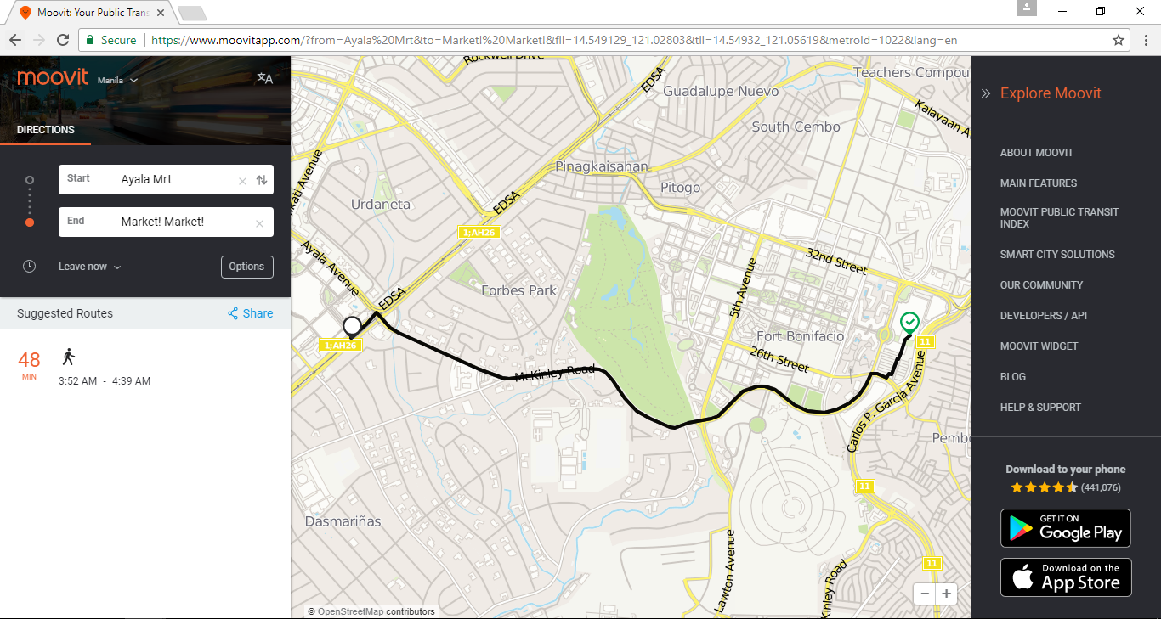
Existing Apps: Moovit

Slide 10
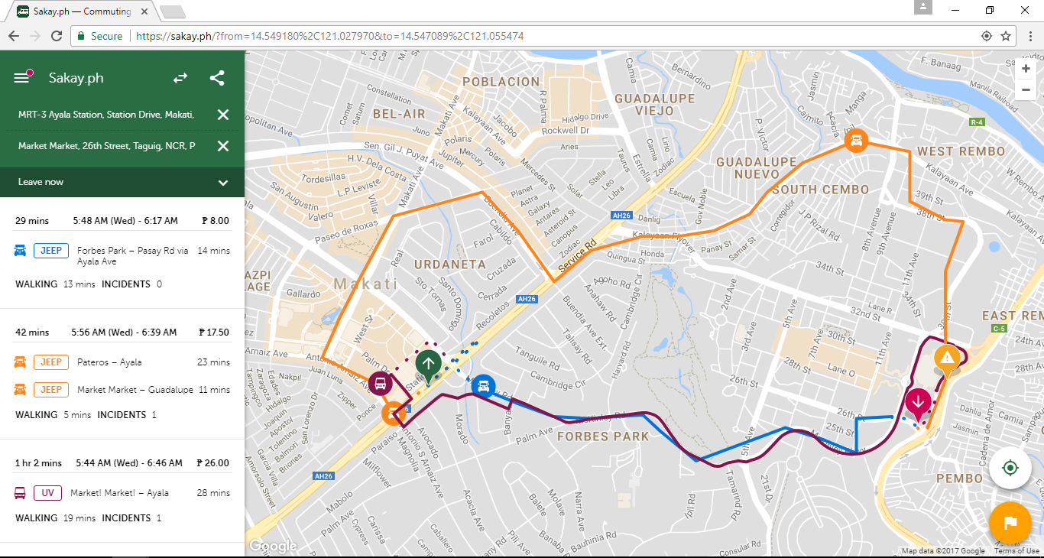
sakay.ph
Existing Apps: Sakay.ph

Slide 11
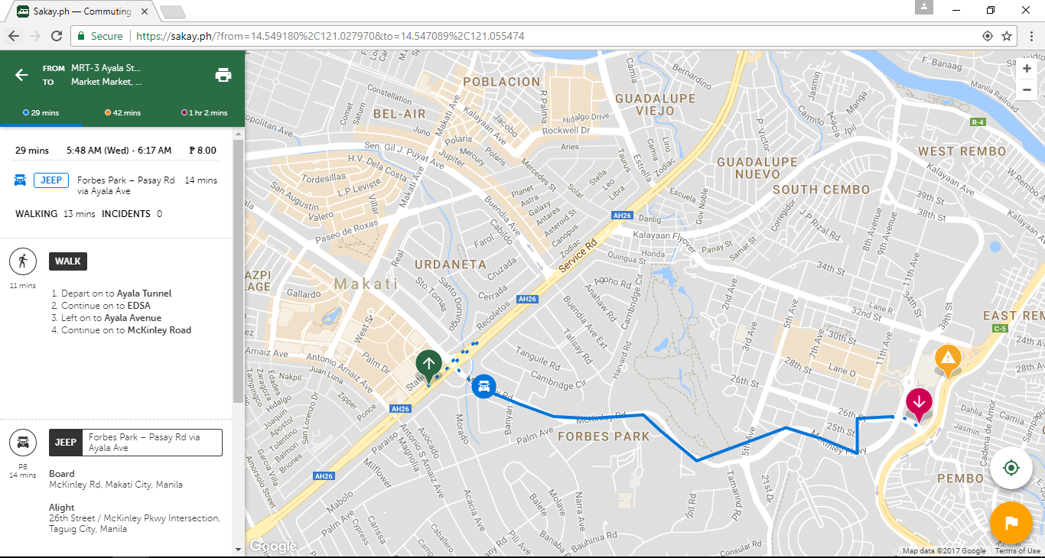
sakay.ph
Existing Apps: Sakay.ph

Slide 12
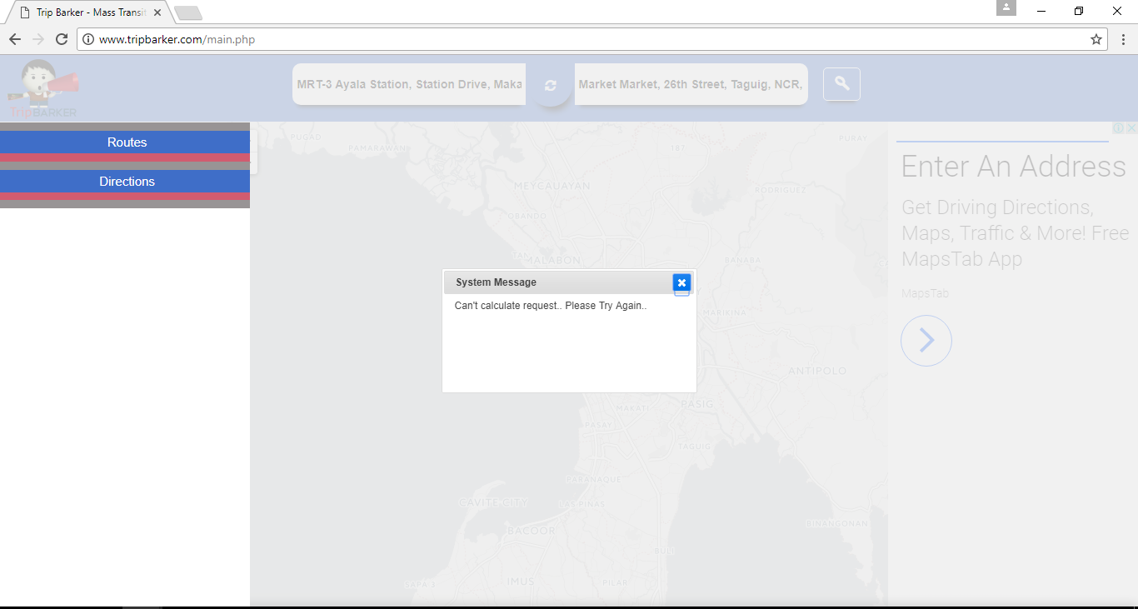
TripBarker
Existing Apps: Trip Barker

Slide 13
Existing Apps
 | Moovit | sakay.ph | TripBarker
Web URL | https://www.moovitapp.com | https://sakay.ph | http://www.tripbarker.com
Google Play Store | ✔ | ✔ | ✔
Apple App Store | ✔ | ✔ | ✖

Slide 14
Bus Tap

Slide 15
Objectives
The Bus Tap aims to be able to:
provide relevant information regarding the BGC Bus;
decrease the waiting time of passengers riding the BGC Bus; and
help users navigate their way around Bonifacio Global City using the BGC Bus.

Slide 16
Features
Detailed Itineraries
– 66% of the BGC Bus passengers will find this feature useful
GPS for transit
Step-by-step guidance from origin to destination
Estimated travel time
Fare
Get Off Alerts

Slide 17
Features
Operation Status
Operating Schedule
Bus Routes, Bus Stops, Points of Interest – 66%
Arrival Times and Departure Times – 75%
Estimated Time of Arrival – 50%
Bus Locator – 58%

Slide 18
Features
Passenger Congestion Status, Congestion Forecast – 42%
Seat Reservation (limited to select bus stops and terminals)
Users can check the remaining balance on their Beep card – 75%
Locations of Beep card loading stations – 58%

Slide 19
Features Comparison
Features | Moovit | sakay.ph | TripBarker | Bus Tap
Commuting routes | ✔ | ✔ | ✔ | ✔
Arrival and departure times | ✖ | ✖ | ✖ | ✔
Estimated time of arrival | ✖ | ✖ | ✖ | ✔
Bus location | ✖ | ✖ | ✖ | ✔
Seat reservation | ✖ | ✖ | ✖ | ✔
Beep card balance | ✖ | ✖ | ✖ | ✔

Slide 20
Scope and Limitations
both web and mobile
for Android devices only
for BGC Bus only
limited to within BGC and select areas of Taguig City (Arca South Express), Makati City (Ayala Express), and Sta. Rosa, Laguna (Nuvali Express)
seat reservation is limited to select BGC bus stops and terminals

Slide 21
UML Diagrams

Slide 22
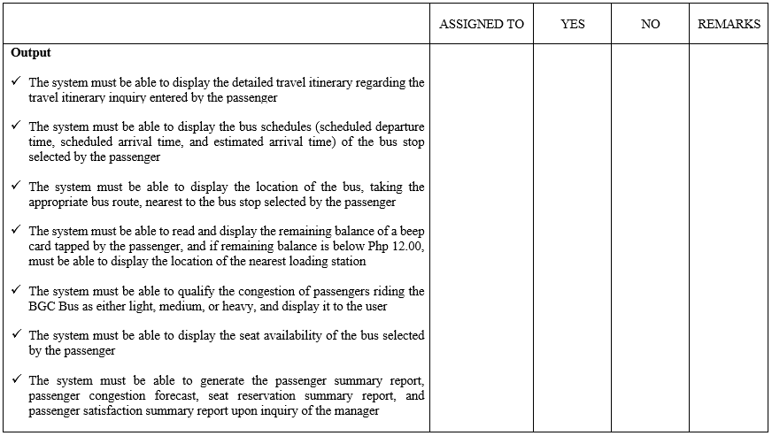
Software Requirements Specification (SRS)

Slide 23
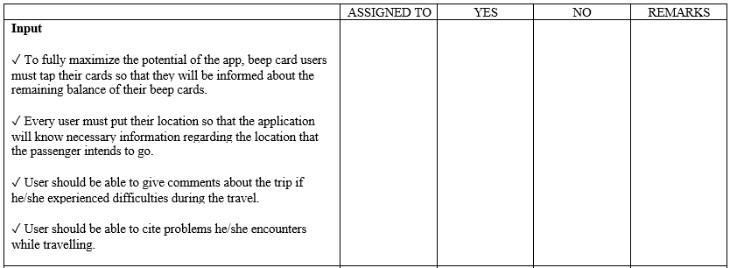
Software Requirements Specification (SRS)

Slide 24
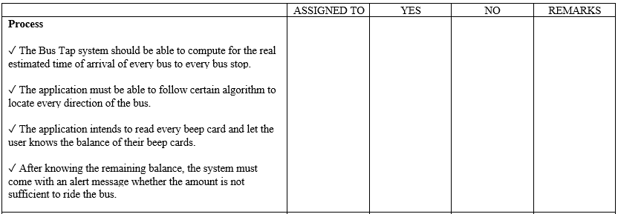
Software Requirements Specification (SRS)

Slide 25
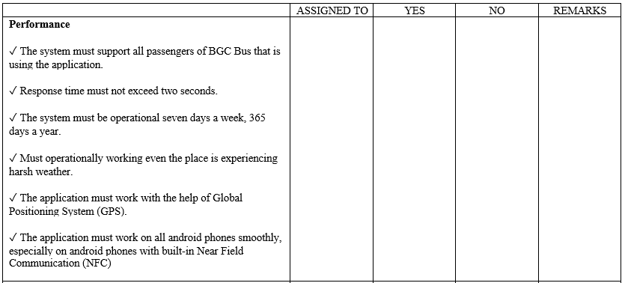
Software Requirements Specification (SRS)

Slide 26
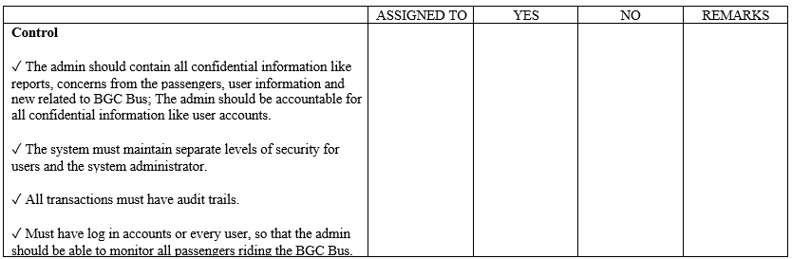
Software Requirements Specification (SRS)

Slide 27
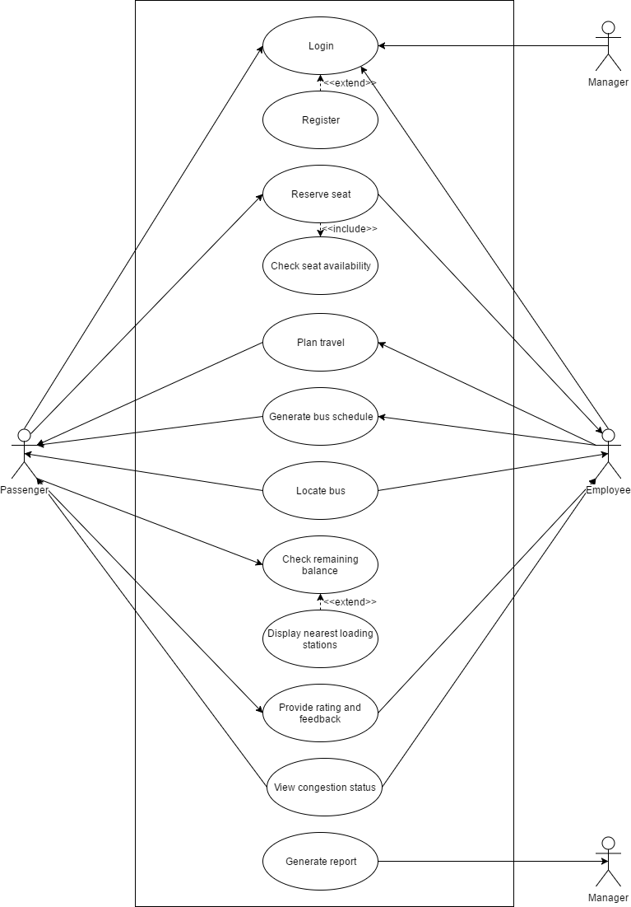
Use Case Diagram

Slide 28
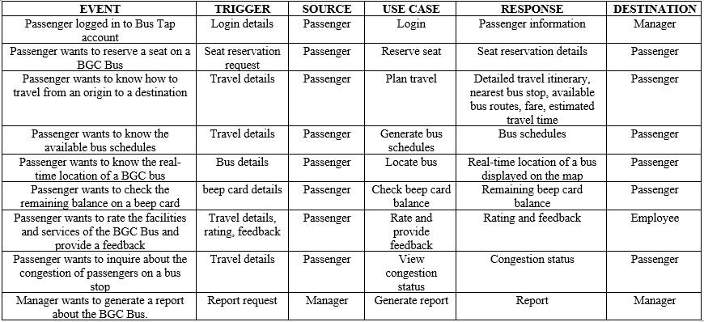
Event Table

Slide 29
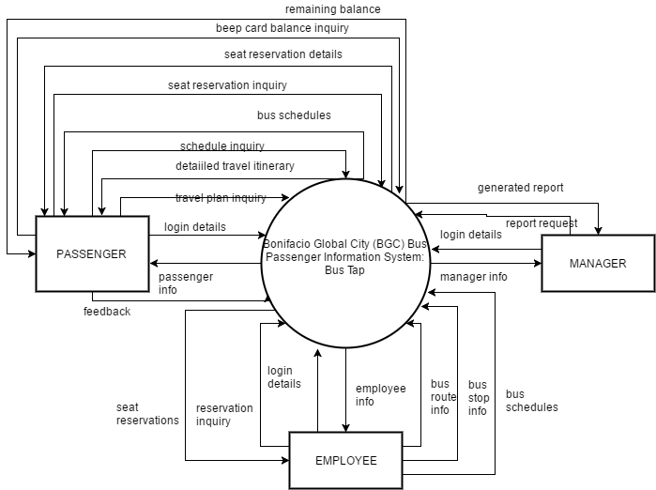
Data Flow Diagram
Context Diagram

Slide 30
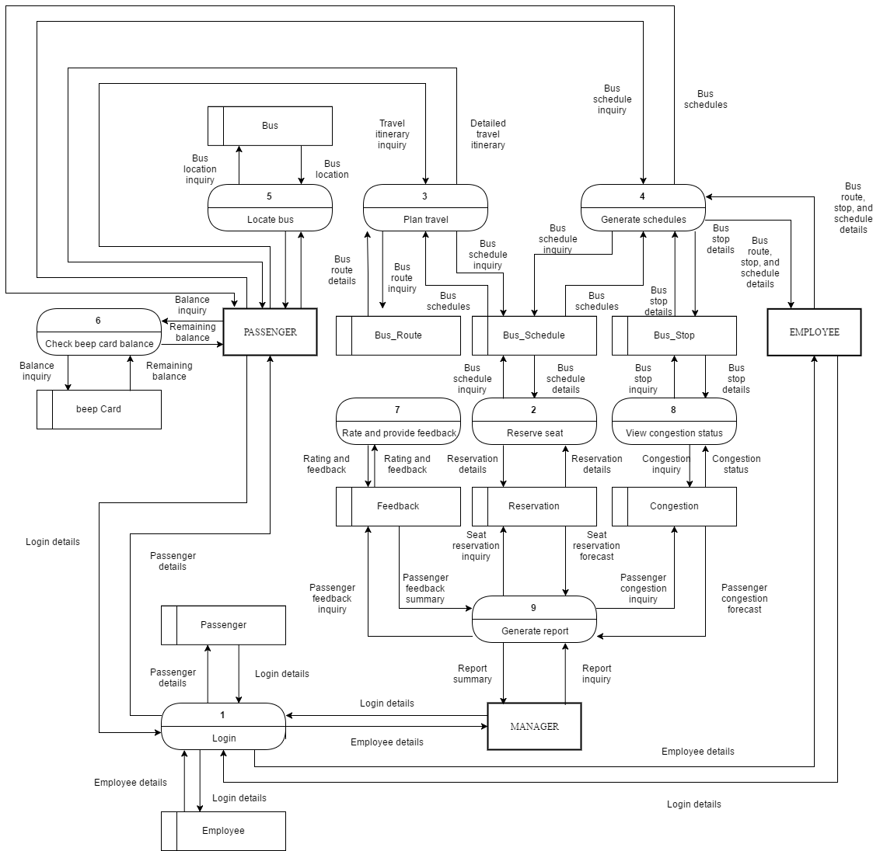
DFD Level 1

Slide 31
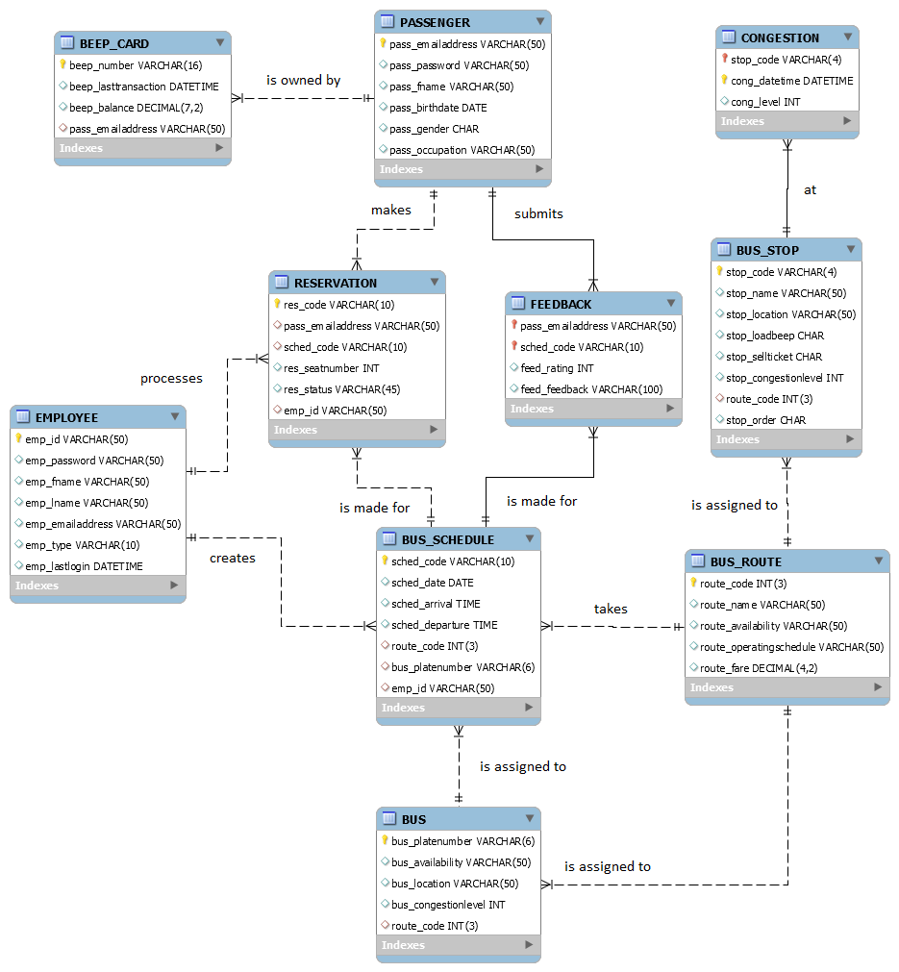
Entity Relationship Diagram (ERD)

Slide 32
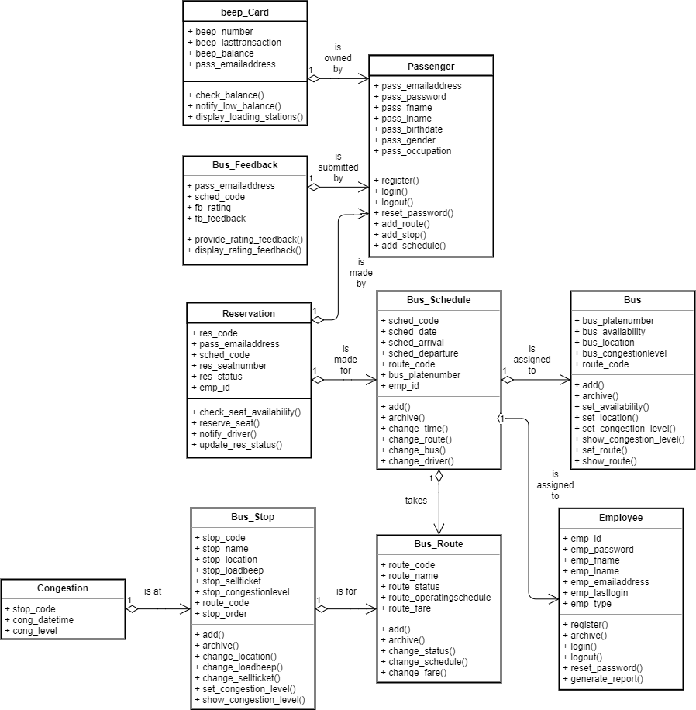
Class Diagram

Slide 33
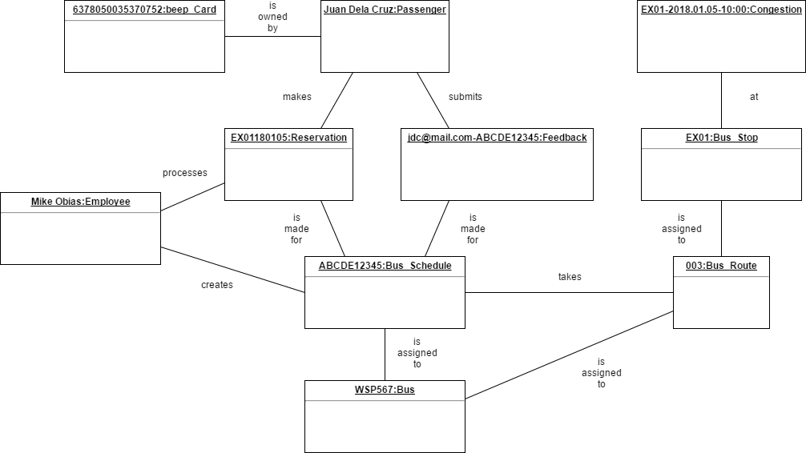
Object Diagram

Slide 34
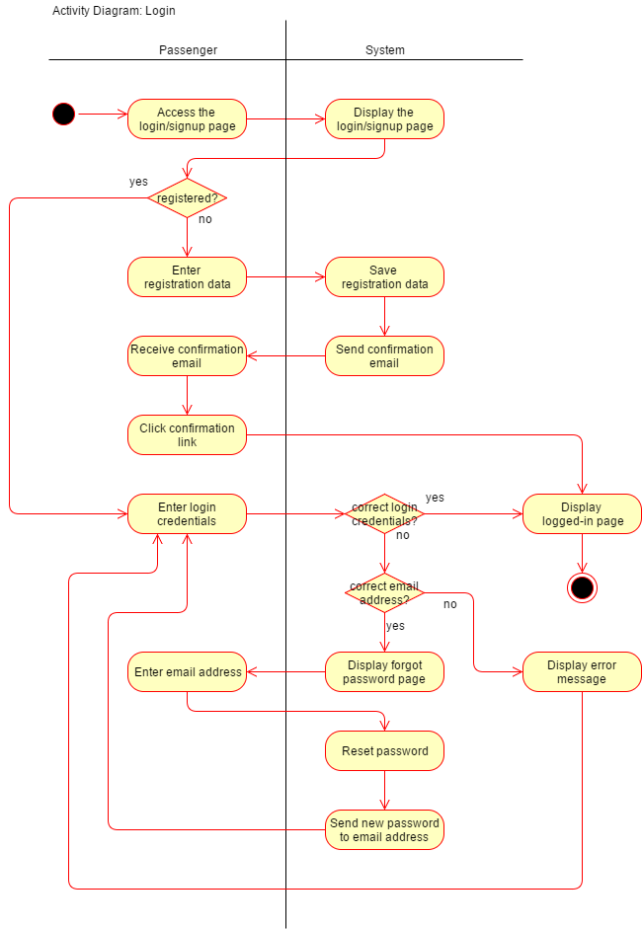
Activity Diagram: Login

Slide 35
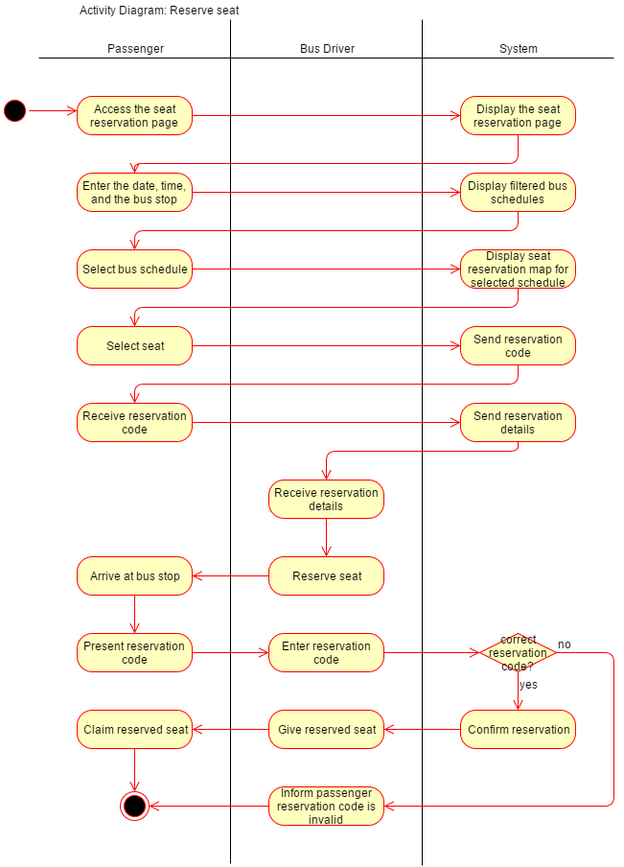
Activity Diagram: Reserve seat

Slide 36
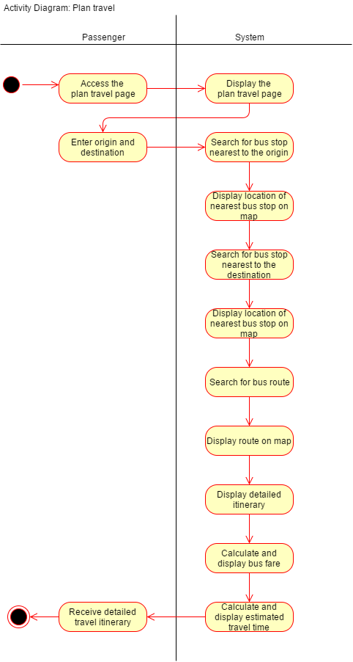
Activity Diagram: Plan travel

Slide 37
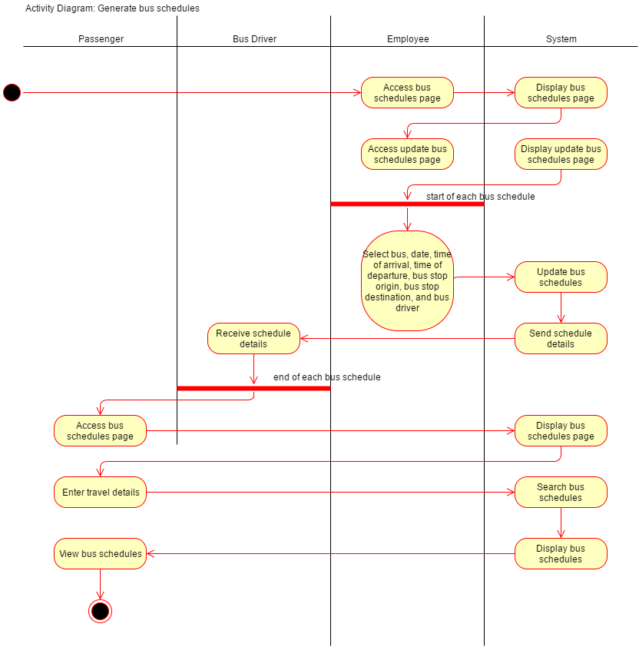
Activity Diagram: Generate bus schedules

Slide 38
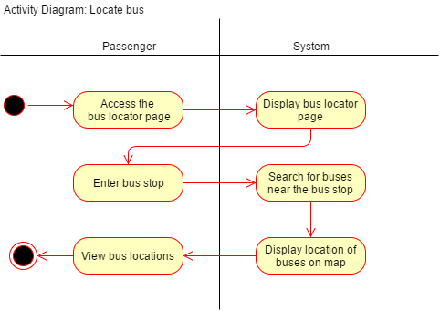
Activity Diagram: Locate bus

Slide 39
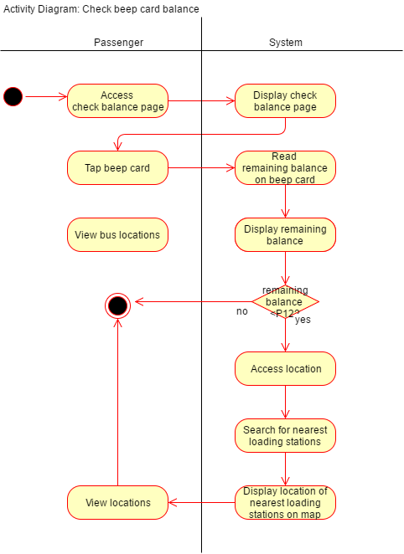
Activity Diagram: Check beep card balance

Slide 40
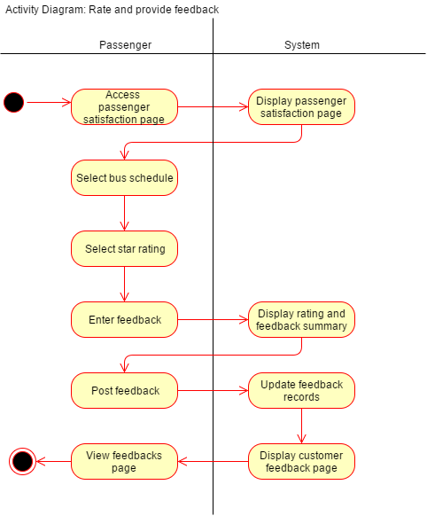
Activity Diagram: Rate and provide feedback

Slide 41
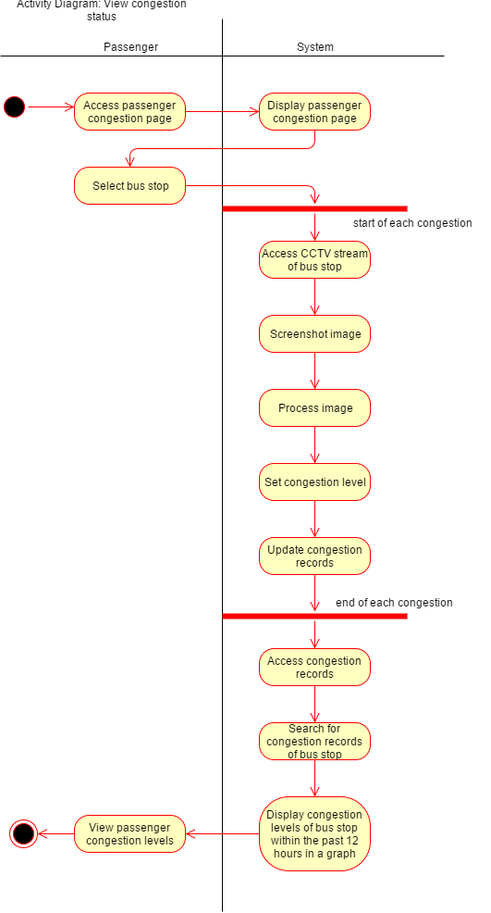
Activity Diagram: View congestion

Slide 42
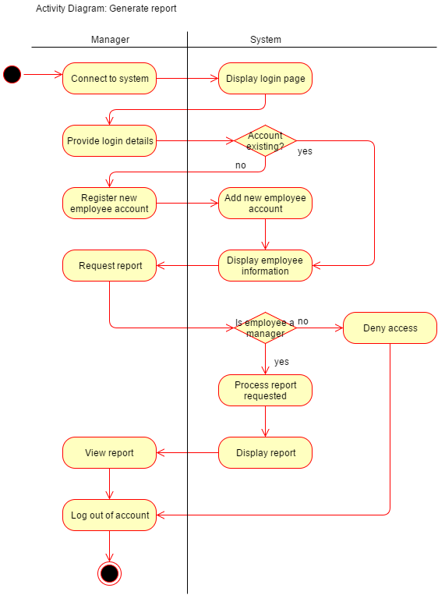
Activity Diagram: Generate report

Slide 43
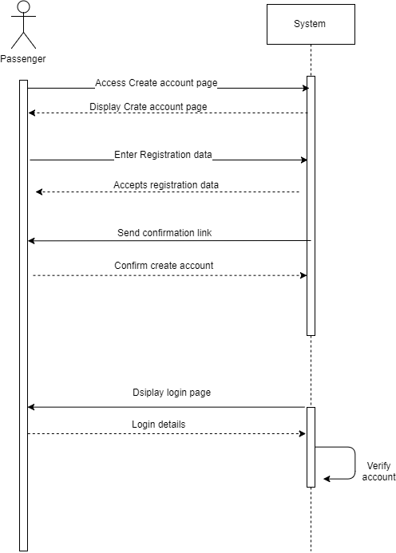
Sequence Diagram: Login

Slide 44
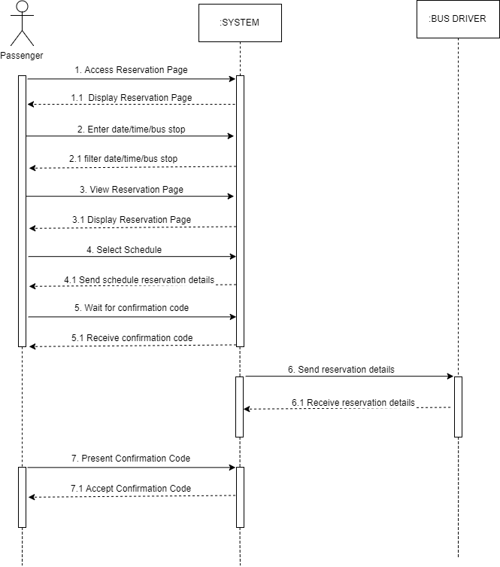
Sequence Diagram: Reserve seat

Slide 45
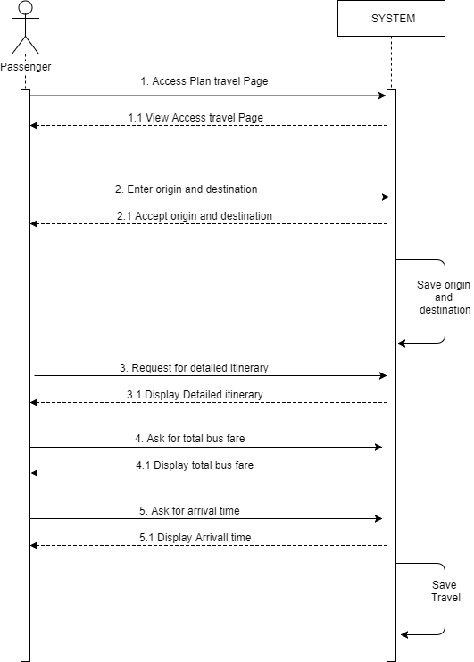
Sequence Diagram: Plan travel

Slide 46
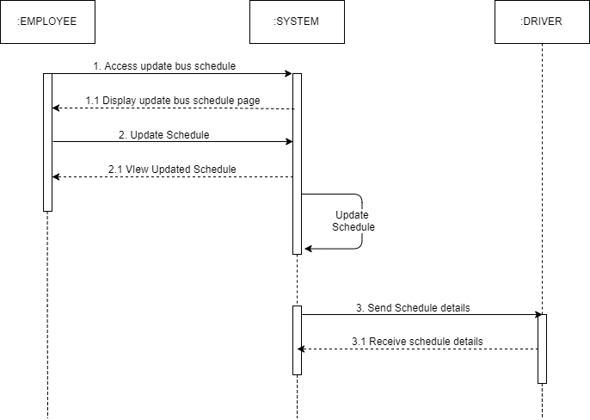
Sequence Diagram: Generate bus schedules (employee)

Slide 47
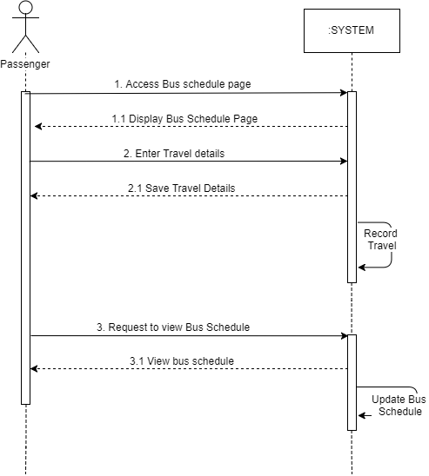
Sequence Diagram: Generate bus schedules (passenger)

Slide 48
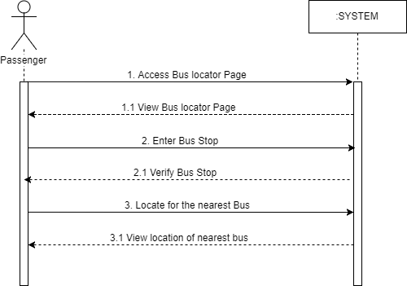
Sequence Diagram: Locate bus

Slide 49
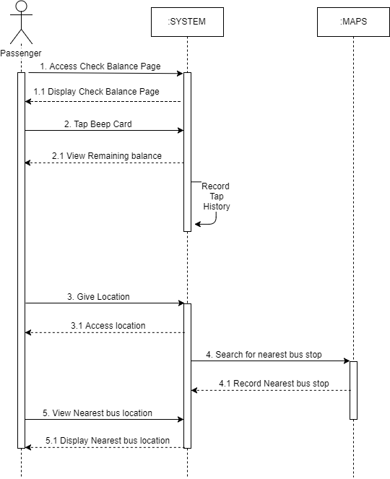
Sequence Diagram: Check beep card balance

Slide 50
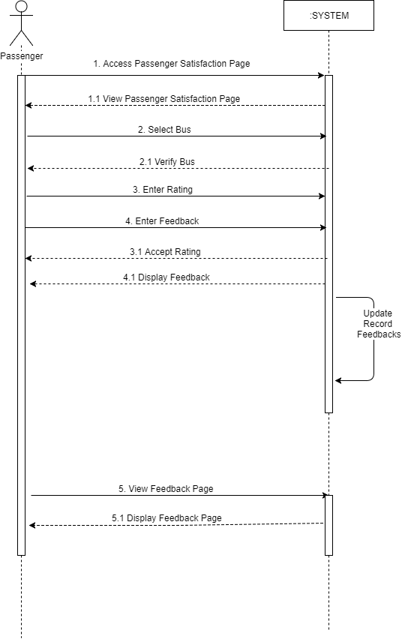
Sequence Diagram: Rate and provide feedback

Slide 51
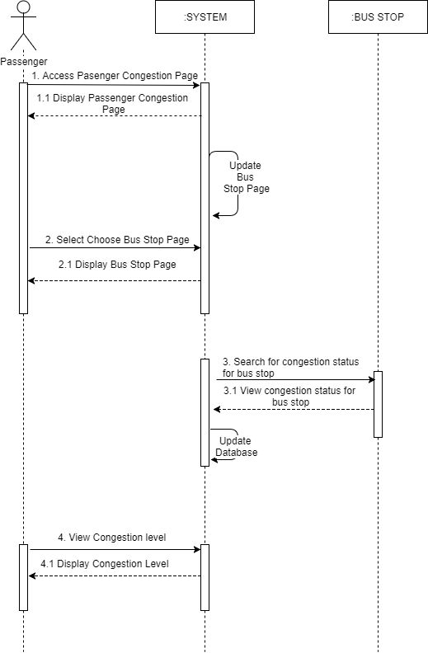
Sequence Diagram: View congestion status

Slide 52
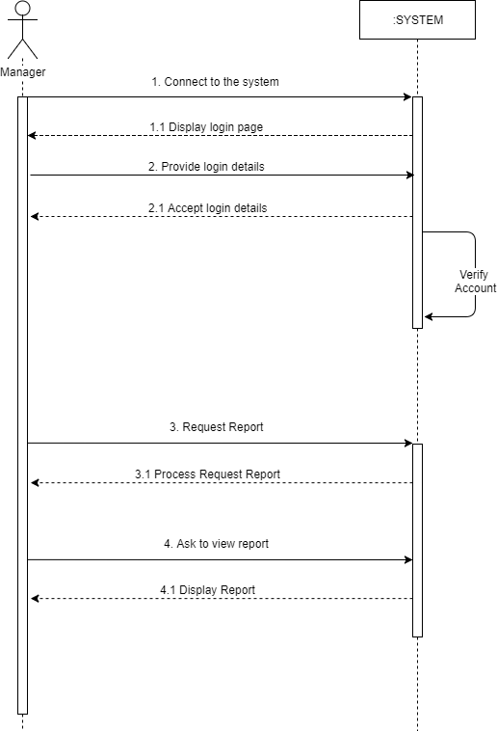
Sequence Diagram: Generate report

Slide 53
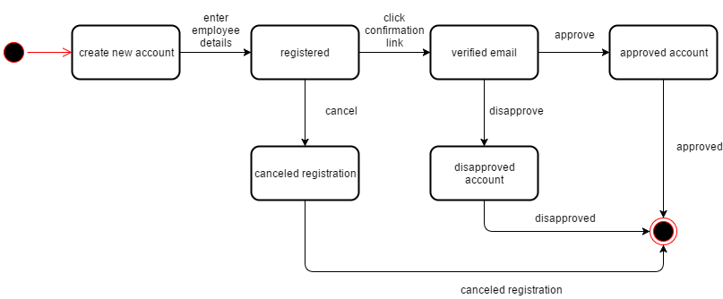
State Diagram: Passenger and Employee

Slide 54
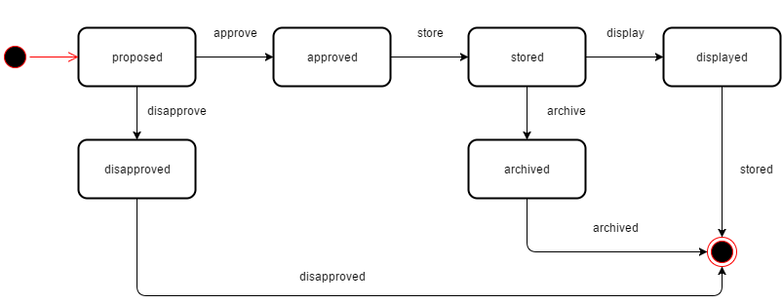
State Diagram: Bus Route and Bus Stop

Slide 55
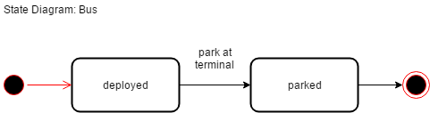
State Diagram: Bus

Slide 56
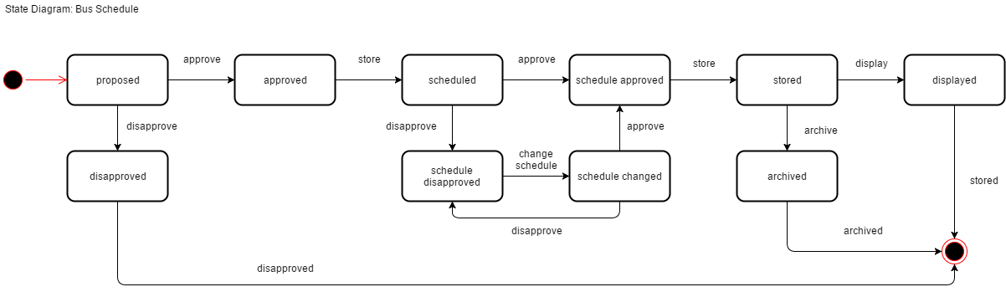
State Diagram: Bus Schedule

Slide 57
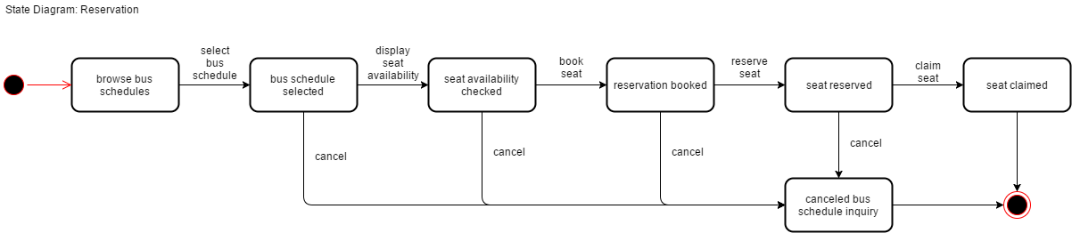
State Diagram: Reservation

Slide 58
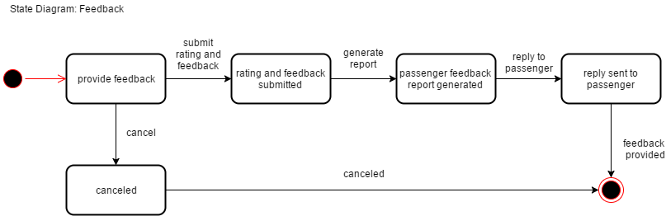
State Diagram: Feedback

Slide 59
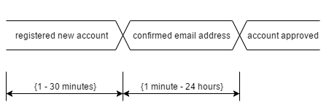
Timing Diagram: Passenger and Employee

Slide 60
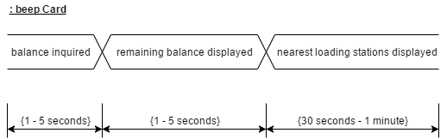
Timing Diagram: beep Card

Slide 61
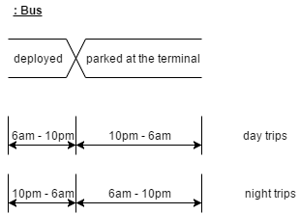
Timing Diagram: Bus

Slide 62
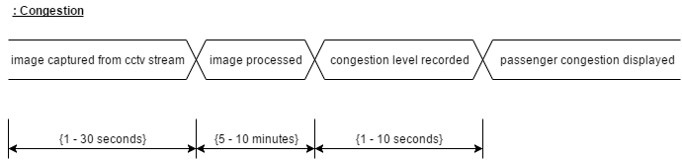
Timing Diagram: Congestion

Slide 63
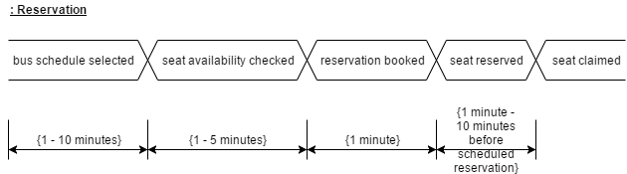
Timing Diagram: Reservation

Slide 64
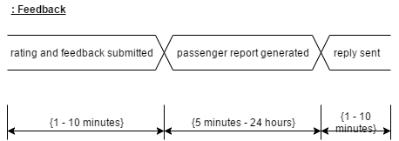
Timing Diagram: Feedback

Slide 65
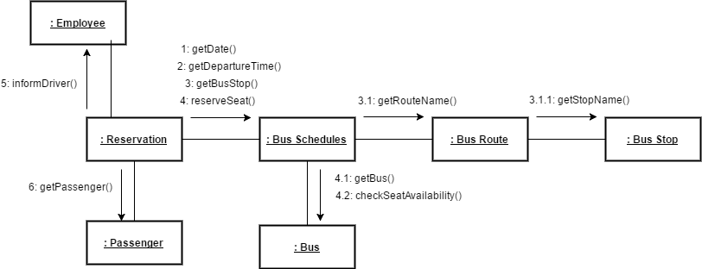
Communication Diagram: Reserve seat

Slide 66

Communication Diagram: Plan travel

Slide 67

Communication Diagram: Display bus schedules

Slide 68

Package Diagram

Slide 69

Component Diagram

Slide 70

Deployment Diagram

Slide 71

Composite Structure Diagram

Slide 72
Thank you

Slide 73

Functional Description Diagram (FDD)

Slide 74

Full Use Case Description

Slide 75

Full Use Case Description

Slide 76

Full Use Case Description

Slide 77

Full Use Case Description

Slide 78

Full Use Case Description

Slide 79

Full Use Case Description

Slide 80

Full Use Case Description

Slide 81

Full Use Case Description

Slide 82
Data Dictionary
ENTITY: BEEP_CARD
Attribute Name | Data Type
beep_number | VARCHAR(16)
beep_lasttransaction | DATETIME
beep_balance | DECIMAL(7,2)
pass_emailaddress | VARCHAR(50)

Slide 83
Data Dictionary
ENTITY: PASSENGER
Attribute Name | Data Type
pass_emailaddress | VARCHAR(50)
pass_password | VARCHAR(50)
pass_fname | VARCHAR(50)
pass_lname | VARCHAR(50)
pass_birthdate | DATE
pass_gender | CHAR
pass_occupation | VARCHAR(50)

Slide 84
Data Dictionary
ENTITY: RESERVATION
Attribute Name | Data Type
res_code | VARCHAR(10)
pass_emailaddress | VARCHAR(50)
sched_code | VARCHAR(10)
res_seatnumber | INT
res_status | VARCHAR(45)
emp_id | VARCHAR(50)

Slide 85
Data Dictionary
ENTITY: FEEDBACK
Attribute Name | Data Type
pass_emailaddress | VARCHAR(50)
sched_code | VARCHAR(10)
feed_rating | INT
feed_feedback | VARCHAR(100)

Slide 86
Data Dictionary
ENTITY: BUS
Attribute Name | Data Type
bus_platenumber | VARCHAR(6)
bus_availability | VARCHAR(50)
bus_location | VARCHAR(50)
bus_congestionlevel | INT
route_code | INT(3)

Slide 87
Data Dictionary
ENTITY: BUS_SCHEDULE
Attribute Name | Data Type
sched_code | VARCHAR(10)
sched_date | DATE
bus_platenumber | VARCHAR(6)
route_code | INT(3)
sched_arrival | TIME
sched_departure | TIME
emp_id | VARCHAR(50)

Slide 88
Data Dictionary
ENTITY: EMPLOYEE
Attribute Name | Data Type
emp_id | VARCHAR(50)
emp_password | VARCHAR(50)
emp_fname | VARCHAR(50)
emp_lname | VARCHAR(50)
emp_emailaddress | VARCHAR(50)
emp_type | VARCHAR(10)
emp_lastlogin | DATETIME

Slide 89
Data Dictionary
ENTITY: BUS_ROUTE
Attribute Name | Data Type
route_code | INT(3)
route_name | VARCHAR(50)
route_availability | VARCHAR(50)
route_operatingschedule | VARCHAR(50)
route_fare | DECIMAL(4,2)

Slide 90
Data Dictionary
ENTITY: BUS_STOP
Attribute Name | Data Type
stop_code | VARCHAR(4)
stop_name | VARCHAR(50)
stop_location | VARCHAR(50)
stop_loadbeep | CHAR
stop_sellticket | CHAR
stop_congestionlevel | INT
route_code | INT(3)
stop_order | INT

Slide 91
Data Dictionary
ENTITY: CONGESTION
Attribute Name | Data Type
stop_code | VARCHAR(4)
cong_datetime | DATETIME
cong_level | INT

